Slide 1

Gradually interpretable models via component-wise boosting
Master Thesis
Lorenz Haller

Slide 2
Outline
Motivation:
Importance of Interpretability (so far mainly focus on accuracy…)
Demand for methods that combine accuracy and interpretability
2. Related Work:
„Technical“ Comparison to similar methods (Linear Model, Lasso, GA2M, GAMBoost, .. ) from practice and literature using different metrics (Performance, Sparsity, Interpretability)
3. Introduction to Gradient Boosting and Componentwise Boosting

Slide 3
Outline
Introduction of own method
Idea behind
Implementation Details (Three Phases/Steps, Choice of base learners, Stop Criterion)
Benchmark Study
Different data sets (Regression/Classification, Few/many features, Good/bad performance)
Different parametrizations of own method
Comparison to different other methods (that also adress the issue of interpretability?)

Slide 4
Zusammenfassung der Arbeit
Mehrstufiges Verfahren unter Verwendung von Componentwise Boosting
Will den Trade-Off zwischen Prädiktionsgüte und Interpretierbarkeit besser berücksichtigen
Aktuell drei Phasen mit unterschiedlichen Baselearnern, hart voneinander getrennt:
Lineare Komponenten (lineares Modell)
Nicht-lineare Komponenten (über Splines)
Feature Interaktionen (Trees)
Comp. Boosting mit Baselearnern einer Phase bis keine weitere Verbesserung
→ Dann Übergang zur nächsten Phase

Slide 5
Zusammenfassung der Arbeit
Übergang zwischen den Phasen über eine minimal notwendige Verbesserung des Risikos von einer Phase auf die nächste
ꜫ
Eine Phase läuft, solange der Quotient aus dem Risiko einer Iteration und dem Risiko aus der Iteration davor größer als ꜫ ist:
while((iteration <= mstop) & (risk[iteration-1]/risk[iteration] >= 1+ꜫ )){
…
}

Slide 6
Implementation (aktuell)
Boosting der linearen Komponenten in Phase I eigenständig implementiert
Phase II (Splines) und III (Trees) als Wrapper über mboost, die in jeder Iteration ein mboost-Modell (mit mstop=1) fitten
Abspeichern der Modelle bzw. Parameter jeder Iteration zur späteren Nutzung in der predict-Funktion

Slide 7
Pseudo-Code: Initialisierung
interpretable_comp_boost_m <- function(data, formula, nu=0.05, mstop=200, family=Gaussian(), epsilon = 0.0025){
…
ngradient <- family@ngradient
riskfct <- family@risk
…
Fit intercept model as initial fit and calculate risk
intercept_model <- lm.fit(x=X[,1]), y=y)
fit_0 <- intercept_model$fitted.values
risk_0 <- riskfct(y = y, f = fitted_values)
lm_coeffs = numeric(dim(X)[2])
lm_coeffs[1] <- intercept_model$coefficients[1]

Slide 8
Pseudo-Code: Phase I Linear Models
while((iteration <= mstop) & ((risk[iteration-1]/[iteration]) >= (1 + epsilon))){
risk_temp <- riskfct(y = y, f = fitted_values)
u <- ngradient(y = y, f = fitted_values)
lm_coeffs_temp = numeric(dim(X)[2])
for(feat in 1:dim(X)[2]){
bl_model <- lm.fit(x=X[,feat], y=u)
lm_fit[feat] <- riskfct(y=u, f=bl_model$fitted.values)
pred_matrix[,feat] <- bl_model$fitted.values
lm_coeffs_temp[feat] <- bl_model$coefficients
}

Slide 9
Pseudo-Code: Phase I Linear Models
model_select <- which.min(lm_fit)
lm_coeffs[model_select] <- lm_coeffs[model_select] + nu * lm_coeffs_temp[model_select]
fitted_values <- X_scaled_lin %*% lm_coeffs
risk[iteration+1] <- riskfct(y = y, f = fitted_values)
}

Slide 10
Pseudo-Code: Phase II Splines
data_temp[,target] <- ngradient(y = y, f = fitted_values)
while((iteration <= mstop) & ((risk_temp / risk_iter[iteration+1]) >= (1 + epsilon))){
risk_temp <- riskfct(y = y, f = fitted_values)
u <- ngradient(y = y, f = fitted_values)
mb_spline = mboost::gamboost(formula = formula, data = data_temp, family = family, baselearner = "bbs", control = boost_control(nu = nu, mstop = 1))

Slide 11
Pseudo-Code: Phase II Splines
mboost_coeff = mb_spline$coef()[[1]]
mboost_risk = mb_spline$risk()[2]
coeff_list[[mboost_feature]] <- coeff_list[[mboost_feature]] + mboost_coeff
fitted_values <- fitted_values + mb_spline$fitted()
risk[iteration+1] <- riskfct(y = y, f = fitted_values)
data_temp[,target] <- ngradient(y = y, f = fitted_values)
}

Slide 12
Pseudo-Code: Phase III Trees
while((iteration <= mstop) & ((risk[iteration]/risk[iteration+1]) >= (1 + epsilon))){
risk_temp <- riskfct(y = y, f = fitted_values)
u <- ngradient(y = y, f = fitted_values)
mb_tree = mboost::mboost(formula = formula, data = data_temp, family = family, baselearner = "btree", control = boost_control(nu = nu, mstop = 1))
mboost_risk = mb_tree$risk()[2]
fitted_values <- fitted_values + mb_tree$fitted()
data_temp[,target] <- ngradient(y = y, f = fitted_values)
Hier werden aktuell standardmäßig tree stumps gefittet

Slide 13
Pseudo-Code: Return List
return_list <- list()
return_list[["Coefficients"]] <- coeff_list
return_list[["Fitted_Values"]] <- fitted_values
return_list[["Transition Iterations"]] <-c(transition_splines,transition_trees)
return_list[["Risk"]] <- risk_iter
return_list[["Prediction_Models"]]<- c(linear_coefficients,spline_coefficients,tree_models)
return_list[["Input_Parameters"]] <-c(nu, mstop, epsilon)
return_list[["Riskfunction"]] <- riskfct
return(return_list)

Slide 14
Pseudo-Code: predict-Funktion
icb_predict <- function(icb_object, newdata, target){
prediction <- vector(mode = "numeric", length = dim(newdata)[1])
for (l in 1:length(prediction)){
prediction[l] <- icb_object$Coefficients$Intercept[[1]]
}
while(iteration <= (icb_object$`Transition Iterations`[1]+1)){
pred_iteration <- newdata[,selected_feature] * icb_object$Prediction_Models[[iteration]][pos_feature]
prediction <- prediction + nu * pred_iteration
test_risk[iteration+1] <- icb_object$Riskfunction(y = y, f = prediction) }
Phase I

Slide 15
Pseudo-Code: predict-Funktion
Phase II
while(iteration <= (icb_object$`Transition Iterations`[2]+1)){
mboost_spline_model <- icb_object$Prediction_Models[[iteration]]
pred_iteration <- mboost_spline_model$predict(newdata)
prediction <- prediction + pred_iteration
test_risk[iteration+1] <- icb_object$Riskfunction(y = y, f = prediction)
}
while(iteration < length(icb_object$Risk)){
mboost_tree_model <- icb_object$Prediction_Models[[iteration]]
pred_iteration <- mboost_tree_model$predict(newdata)
prediction <- prediction + pred_iteration
test_risk[iteration+1] <- icb_object$Riskfunction(y = y, f = prediction)
}
Phase III

Slide 16
Pseudo-Code: predict-Funktion
return_list <- list()
return_list[["Predictions"]] <- prediction
return_list[["TestRisk"]] <- test_risk
return(return_list)
}

Slide 17
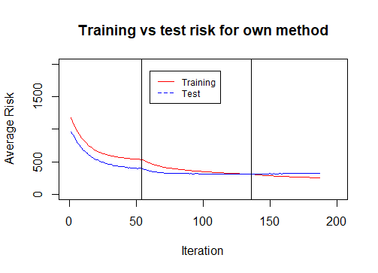

Slide 18
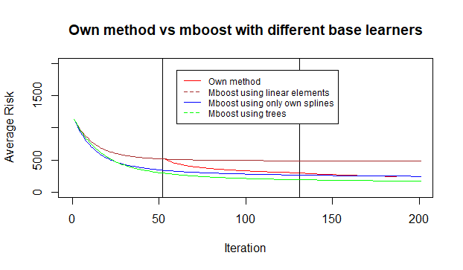

Slide 19

To-Do’s
Visualisierung verschiedener Kennzahlen im Verlauf der Zeit / des Risks: Anzahl der Features, Anzahl der Interaktionen, Nicht-Linearität der Effekte
Outputkurven zum Vergleich der Effekte über die drei Phasen
Partial Dependence Plots
Reduzierung der Größe der von mboost gespeicherten Daten/Modelle
Phase 0 mit Penalty für neue Features

